Slide 1
LASSO REGRESSION (Least Absolute Shrinkage and Selection Operator)
Presented by –
Alisha DJ

Slide 2
INTRODUCTION to LASSO REGRESSTION
It was originally introduced in geophysics, and later by Robert Tibshirani, who coined the term.
Lasso Regression comes under supervised learning model.
Lasso was originally formulated for linear regression models.
Importance of Lasso Regression is that it uses the L1Regularization technique
As complexity of model increases it tends to overfit with data so if we use Lasso Regression the model is made simpler.
Lasso regression is like linear regression, but it uses a technique "shrinkage" where the coefficients of determination are shrunk towards zero.

Slide 3
LITERATURE SURVEY on LASSO REGRESSION
Application of Lasso regression model in the analysis of success probability of electronic experiments. - (2021 IEEE International Conference on Computer Science, Electronic Information Engineering and Intelligent Control Technology (CEI)
An application of Lasso regression in Factor Augmented HAR models. - (August 2021 SSRN Electronic Journal)
A STRESS TEST APPLICATION: FORECASTING PROBABILITIES OF DEFAULT -(Prepared by Jorge A. Chan-Lau )

Slide 4
ADVANTAGES of LASSO REGRESSION
It produces simpler and more interpretable models.
It does shrinkage and variable selection simultaneously.
Reduced overfitting.
Automatic features selection.
It provides greater prediction accuracy as compared to other regression models.
Lasso helps in case of multicollinearity.
Lasso Regularization helps to increase model interpretation.
LASSO models have the “oracle property” combining consistency and efficiency.

Slide 5
APPLICATIONS of LASSO REGRESSION
Application of Lasso Regression includes in its usage in financial and economic forecasting.
Application of Lasso Regression in building forecasting models
Can be used in business to evaluate trends and make estimates
Lasso Regression is a choice for shrinkage estimation and variable selection.
Can be Implemented on Statistical Downscaling Models.

Slide 6
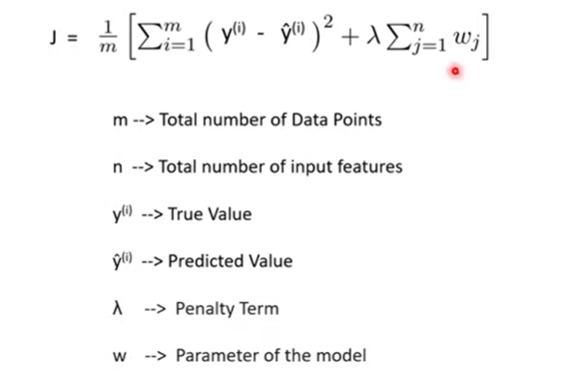
MATH BEHIND LASSO REGRESSION
Lasso Regression Formula
Residual Sum of Squares + λ * (Sum of the absolute value of the magnitude of coefficients) Where,
● λ denotes the amount of shrinkage.
● λ = 0 implies all features are considered and it is equivalent to the linear regression where only the residual sum of squares is considered to build a predictive model
● λ = ∞ implies no feature is considered i.e, as λ closes to infinity it eliminates more and more features
Cost Function for Lasso Regression:
Here lambda is the regularization parameter which is multiplies with the weights.

Slide 7
Thank You

